Slide 1

SCREEN TIME ANALYSIS USING PYTHON
01
By Shagun

Slide 2
Today's agenda
In an era where digital engagement is at an all-time high, understanding screen time patterns is crucial for both personal well-being and business insights. My Screen Time Analysis project dives deep into the data behind our digital habits, revealing fascinating trends and actionable insights.

Slide 3

Project overview
04
In the digital age, screen time has become a significant aspect of our daily lives. This project explores screen time data across various devices to uncover usage patterns and their impact on well-being.
Project Overview:
Data Collection: Analyzed data from mobile devices, computers, and smart TVs.
Behavioral Insights: Identified trends in usage across different demographics.
Impact Analysis: Examined the relationship between screen time and factors like productivity and mental health.
Visualizations: Created engaging charts and graphs to present key findings.
Key Takeaway:
This analysis provides actionable insights for individuals and businesses to better understand and manage digital consumption.
4o

Slide 4
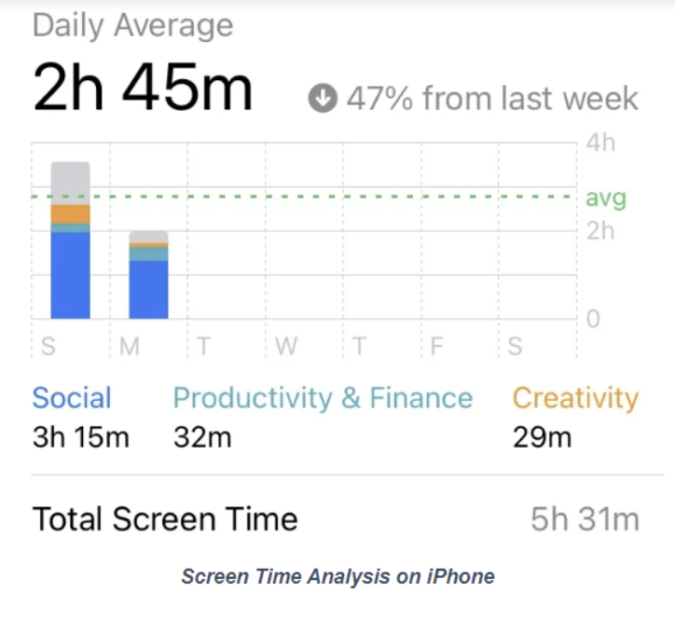
OBJECTIVE OF THIS PROJECT
The objective of the "Screen Time Analysis" project is to illuminate the intricate relationship between digital consumption and well-being by analyzing diverse screen time data. This project aims to uncover unique patterns and behaviors across various demographics, offering actionable insights that empower individuals to optimize their screen habits and businesses to refine their digital engagement strategies. Through this analysis, we strive to contribute to a deeper understanding of the digital era's impact on lifestyle, productivity, and mental health, ultimately fostering a more balanced and informed approach to screen time.
4o

Slide 5
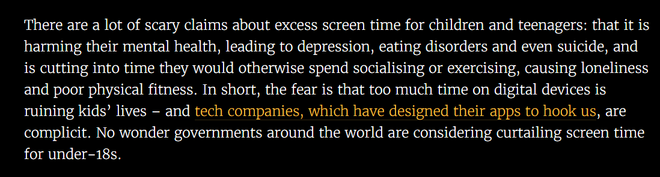
1) Understading the data
03
Data Sources
Description: The dataset comprises screen time details collected from a mobile app.
Period Covered: The dataset spans from August 26, 2022, to October 18, 2022.
Data Composition
Data Types:
Date: The date when the screen time was recorded (object type).
Usage: Total screen time usage in minutes (integer type).
Notifications: Number of notifications received (integer type).
Times opened: Number of times the app was opened (integer type).
App: Name of the app being used (object type).
Number of Records: The dataset contains 54 entries.

Slide 6
Key Variables
Date: The specific day the data was recorded.
Usage: Indicates the amount of time (in minutes) spent using a specific app.
Notifications: Reflects the number of notifications received from the app.
Times opened: Shows how many times the app was opened on that day.
App: The name of the application being analyzed.
Exploratory Data Analysis (EDA)
Initial Insights:
Instagram appears frequently in the sample shown.
There are variations in the number of notifications and times an app is opened each day.
The dataset captures daily usage trends which can be visualized for deeper insights.
Data Quality
Data Cleaning: The dataset appears to have no missing values. Each column is complete with 54 non-null entries.
Data Limitations: The dataset is relatively small, with data collected over less than two months. It may not be representative of broader trends.
Visual Exploration: To understand data distribution and trends, visualizations like line charts for daily usage, bar charts for app comparisons, and scatter plots for notifications vs. usage can be utilized.

Slide 7
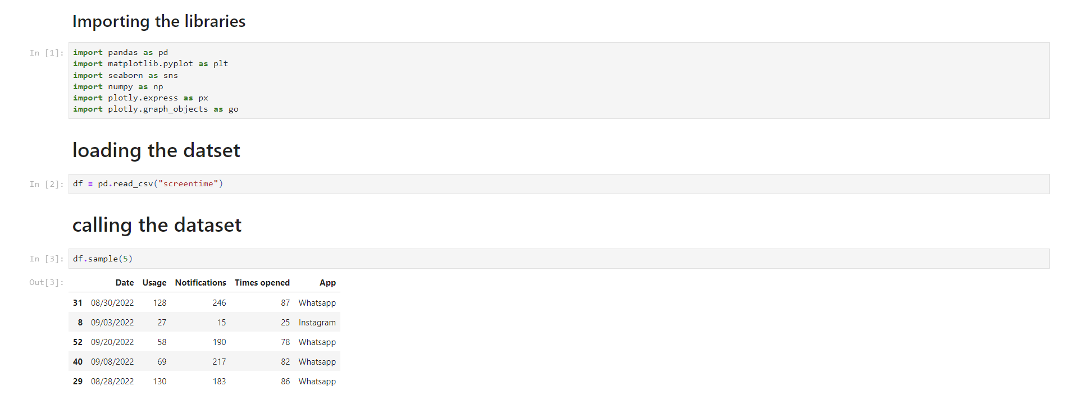
BASIC UNDERSTANDING OF THE DATA

Slide 8
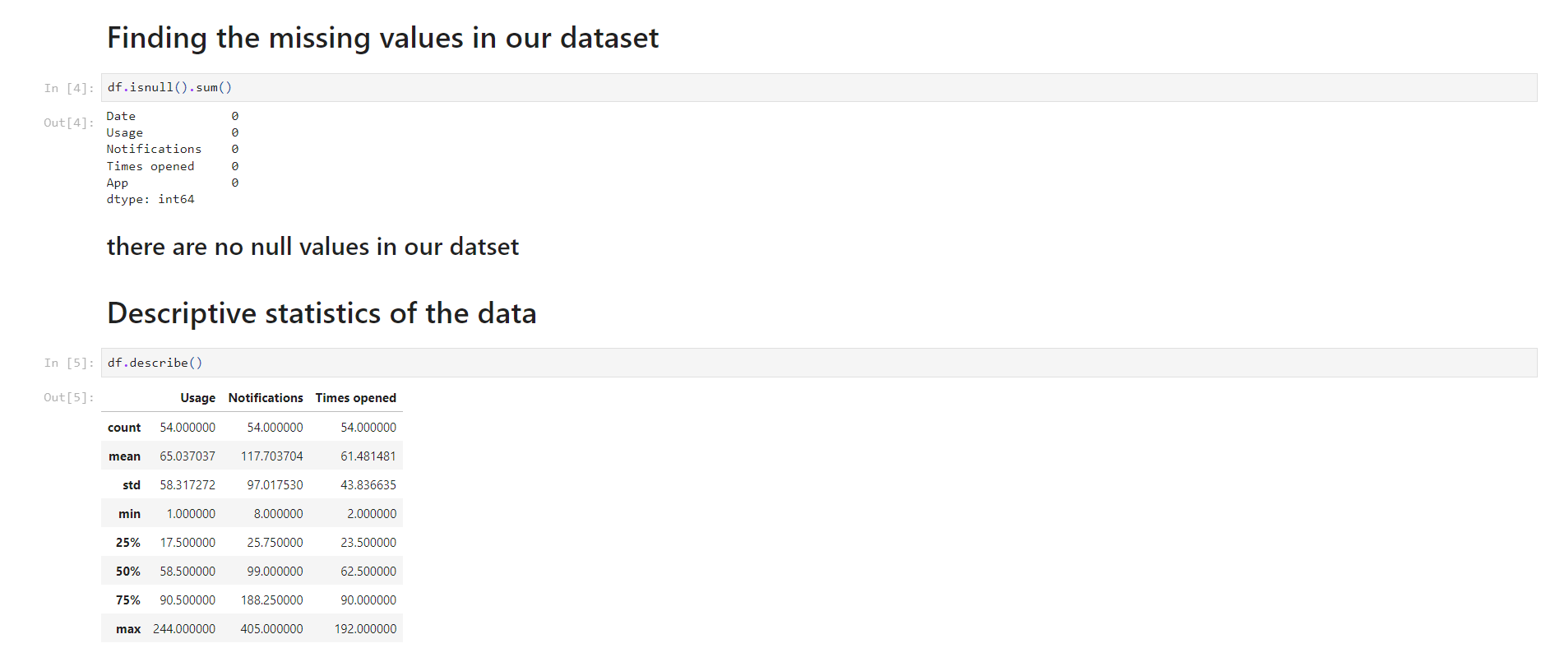
FINDING AND HANDLING MISSING VALUES

Slide 9
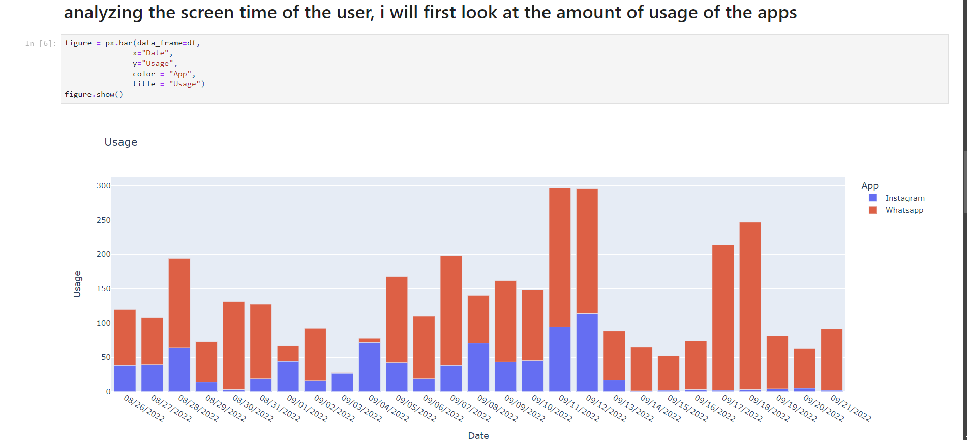
DATA VISUALIZATION

Slide 10
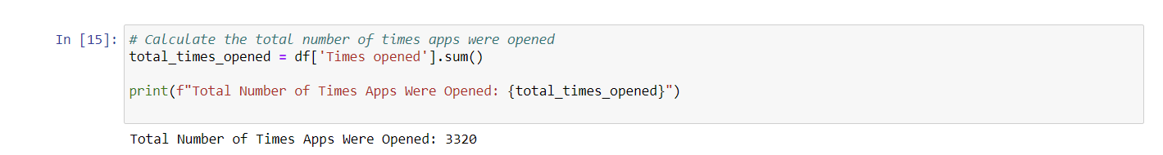
No of times the apps are opened

Slide 11
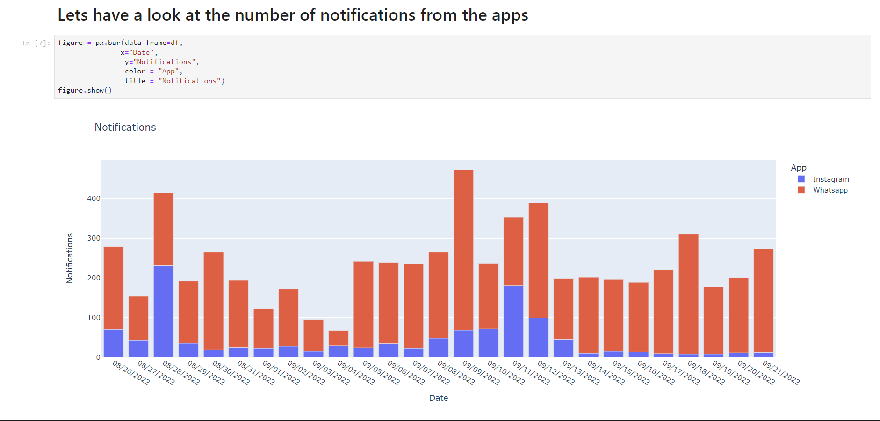
SINCE WE USUALLY USE THE PHONES WHENEVER WE GET NOTIFIED SO WE WILL ANALYZE THE NOTIFICATIONS

Slide 12
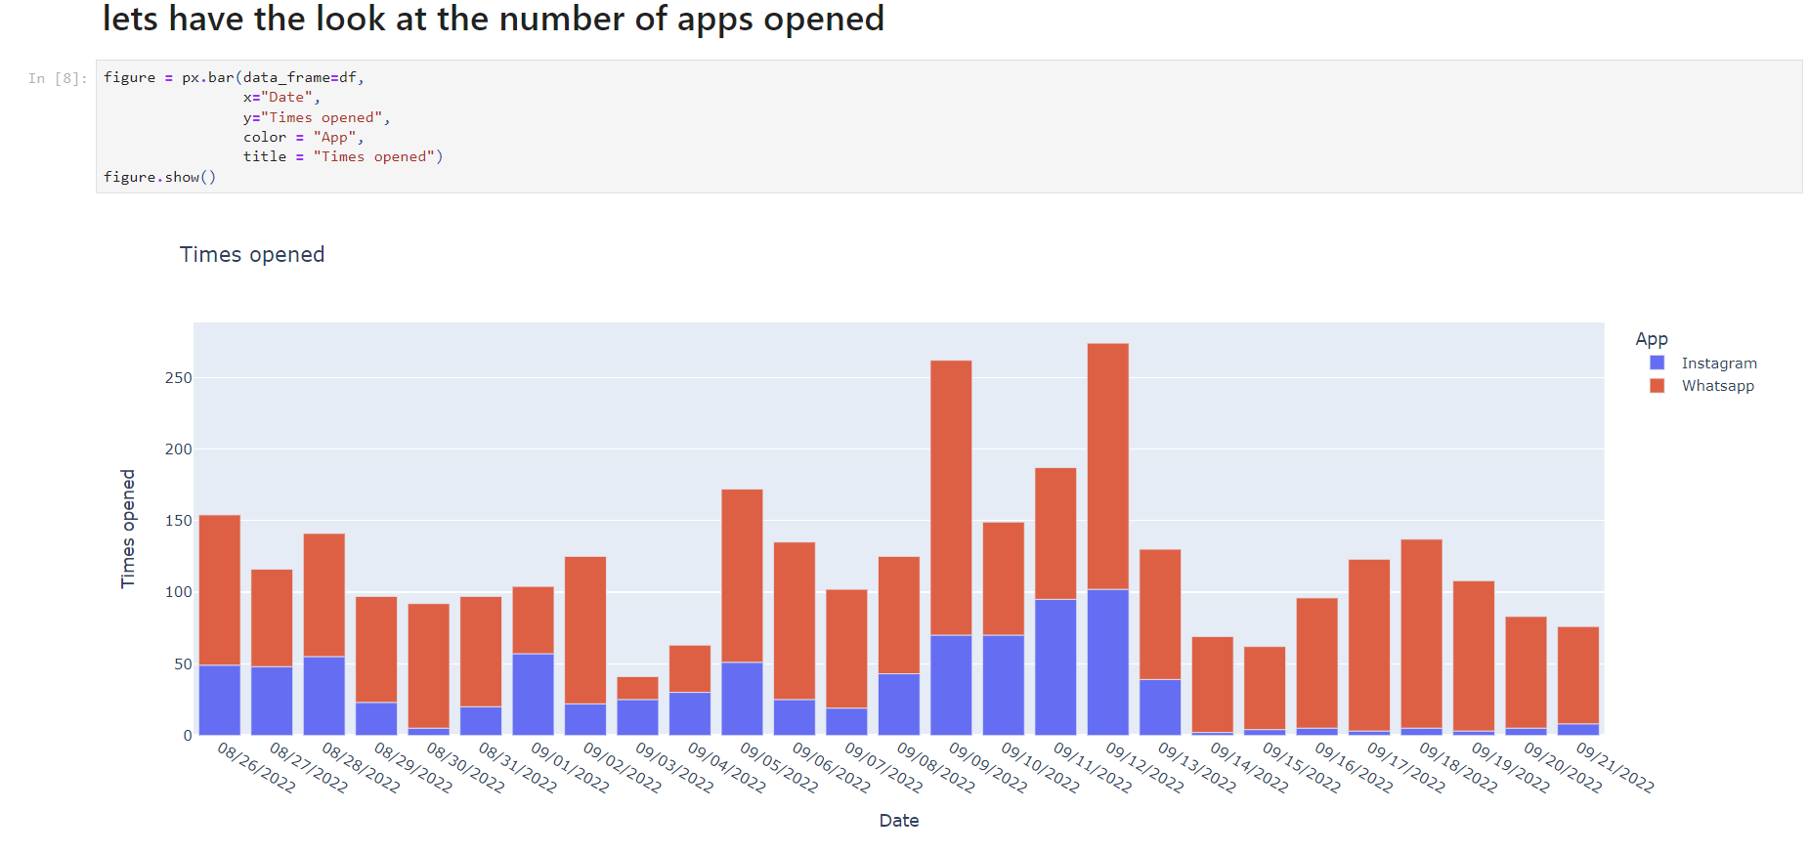
NOW WE WILL ANALYZE THE NUMBER OF TIMES AND NUMBER OF APPS OPENED

Slide 13
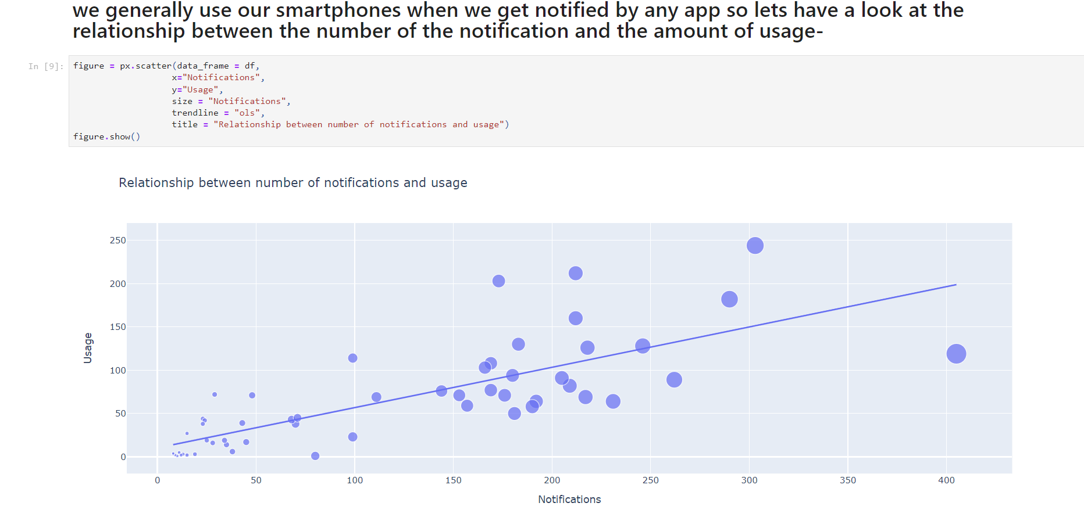
RELATIONSHIP BETWEEN NOTIFICATIONS AND AMOUNT OF USAGE

Slide 14
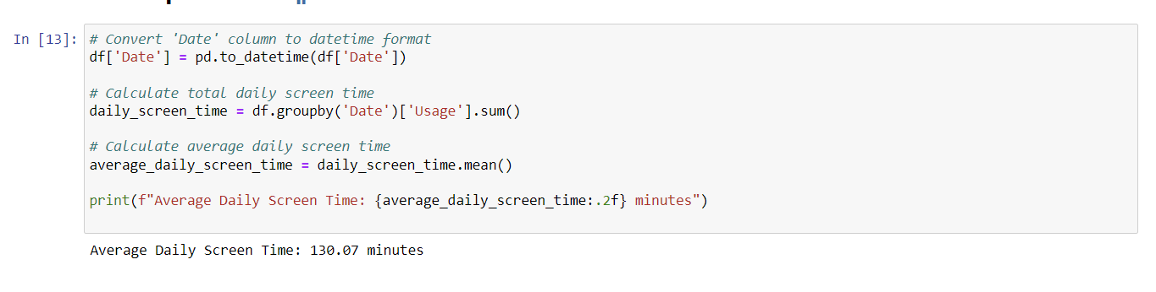
AVERAGE DAILY SCREEN TIME

Slide 15
KEY FINDINGS AND INSIGHTS
Total Number of Times Apps Were Opened:
The apps were opened a total of 3,320 times. This indicates frequent interaction with the apps tracked in the dataset.
Number of Unique Apps:
The dataset includes usage data for 2 unique apps. This helps focus the analysis on specific app usage behaviors.
Most Used App:
WhatsApp is the most used app based on total screen time. This app saw the highest amount of usage compared to others in the dataset.
Average Daily Screen Time:
The average daily screen time is approximately 130.07 minutes. This provides a benchmark for daily device usage.
Relationship Between Notifications and Usage:
There is a strong positive correlation (0.774) between the number of notifications and the amount of usage. This suggests that as the number of notifications increases, the user's screen time also tends to increase. This insight could indicate that notifications play a significant role in driving app engagement.

Slide 16
BUSINESS IMPACTS
Optimizing User Engagement with Notifications:
Insight: There is a linear relationship between the number of notifications and screen time.
Recommendation: Businesses should evaluate their notification strategies to balance engagement without overwhelming users.
Targeting the Most Used Apps:
Insight: WhatsApp is identified as the most used app, indicating high user engagement.
Recommendation: Businesses with similar apps or services should focus on integrating features that enhance user experience and engagement, similar to those seen in WhatsApp.
Benchmarking and Monitoring Daily Screen Time:
Insight: The average daily screen time is approximately 130.07 minutes.
Regularly monitoring screen time trends can help in identifying changes in user behavior and adjusting strategies accordingly.
Strategic Recommendations for App Design and Features:
Insight: The frequent use of certain apps highlights the importance of key features in driving engagement.
Recommendation: Businesses should prioritize features that are highly valued by users, as seen with WhatsApp. Investing in user-friendly design, functional updates, and interactive elements can drive higher engagement and satisfaction.

Slide 17
Thank you for taking the time to review the findings of the Screen Time Analysis. I appreciate your consideration and look forward to any feedback or discussions on how these insights can contribute to enhancing app engagement and user well-being.

